Slide 1



AI Master Class series – Day 27
Title Formation from Paragraph using NLP

Slide 2

Title Formation from Paragraph using NLP
The main purpose of a title is to entice people to make them read your work. A good title helps in garnering all the attention that your article deserves

Slide 3
NLTK
NLTK stands for Natural Language Toolkit.
This toolkit is one of the most powerful NLP libraries which contains packages to make machines understand human language and reply to it with an appropriate response.
Tokenization, Stemming, Lemmatization, Punctuation, Character count, word count are some of these packages which will be discussed in this tutorial.

Slide 4
html5lib
html5lib is a pure-python library for parsing HTML. It is designed to conform to the WHATWG HTML specification, as is implemented by all major web browsers.
Bs4 – Beautiful soup
Beautiful Soup is a Python package for parsing HTML and XML documents. It creates a parse tree for parsed pages that can be used to extract data from HTML, which is useful for web scraping.

Slide 5

Installing Libraries
NLTK - pip install nltk

Slide 6
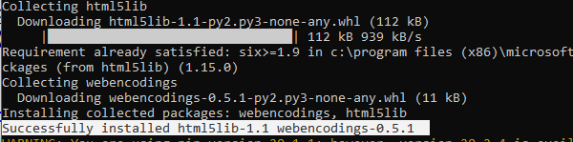
Installing Libraries
html5lib - pip install html5lib

Slide 7
Installing Libraries
html5lib - pip install bs4

Slide 8

! PRACTICAL SESSION !

Slide 9
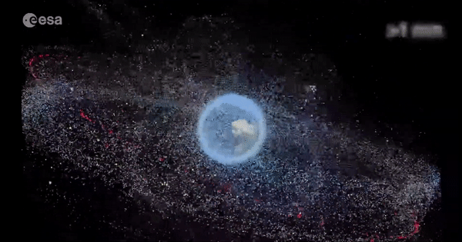
AI News – Day 27. OCT - 2020
The European Space Agency wants to clean up the junk orbiting earth
Space is a messy place. An estimated 34,000 pieces of junk over 10 cm in diameter are currently orbiting Earth at around 10 times the speed of a bullet. If one of them hits a spacecraft, the damage could be disastrous.
ClearSpace-1 will use an AI-powered camera to find the debris. Its robotic arms will then grab the object and drag it back to the atmosphere before burning it up.

Slide 10
Thanks!
Tomorrow session
Title Formation from Paragraph

Slide 11
Day-27 Agenda.
01.
02.
03.
Overview on Title Formation
Installing Libraries
Title formation using NLP
04.
Q & A

